Slide 1
Autonomous Underwater Vehicle Simulation
Motion Models and Path Planning in 3D environment in OMNeT++

Slide 2
Submitted by: Lanka Veera Vishnu Pavan - Matriculation no. : 220200602 Purits Andrei - Matriculation no. : 221202242
Reviewer Dr. -Ing. habil. Peter Danielis Universität Rostock 18059 Rostock, Germany

Slide 3
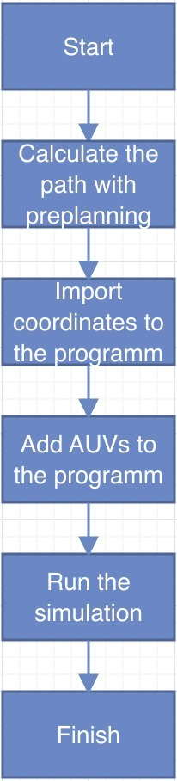
Goal of project
The aim of the project is to perform the best Mobility motion this the most suitable Path planning in 3D environment in OMNeT++. It could be separated into 4 problems:
1. to choose the best mobility model 2. to choose the best Path planning algorithm and calculate the route 3. to implement it in OMNeT++ 4. to add environment with obstacles

Slide 4
Mobility models. Bonn motion.

Slide 5
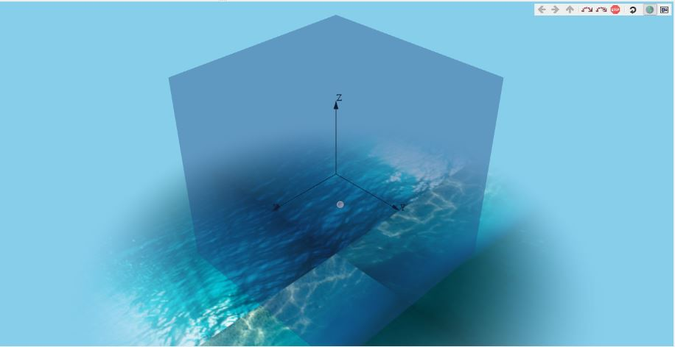
3D Models
The seen of simulation looks like sky blue which is representing water. the form of the node should seem like a submarine or AUV, but it’s sort of a drone. The drone represents an AUV. the realm outside of the acoustic zone is constrained.

Slide 6
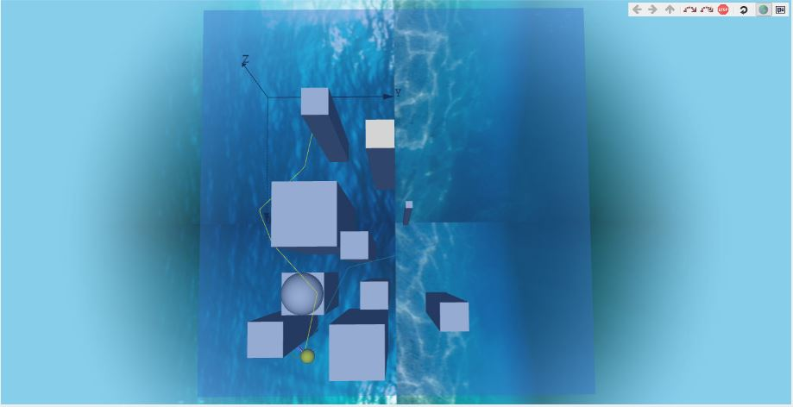
Multiple AUVs
The figure shows that multiple AUVs take alternative paths.
one amongst them is following Dijkstra Algorithm for a higher path. Others are using the subsequent best paths, which started from different starting location.
The yellow color path represents the AUV following the Dijkstra Algorithm. The blue color represents the choice paths. From the figure, one can observe that goal position which is representing as yellow sphere.

Slide 7
Results
Mobility model
We have chosen BonnMotionMobility in our project, cause this Motion Mobility can be used both in 2D and 3D cases and it has path preplanning option that was very useful in this project.
Dijkstra Algorithm
One of the most challenges with wireless AUVs is proscribed energy. Keeping energy consumption a vital target. We’ve calculated the shortest path to achieve the goal position. which the results are very accurate.
Implementation
The implementation of our code was successful and it works fine on OMNeT++ version 5.7.
Environment and obstacles
We created simulation environment in the shape of a cube with size of 2000m. Also we added obstacles and calculated the shorted path through them.
Global path planning
In different varieties of path planning, we focused on Global path planning with static obstacles.

Slide 8
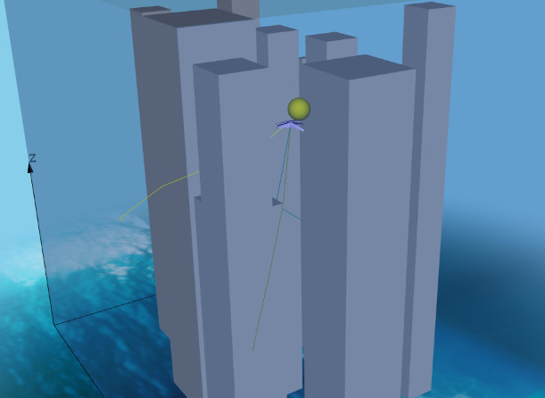
Results
At the very end we have got 3 drones, which started at different positions and get to the end point, avoiding obstacles, in the shortest time.

